Slide 1
Discrete Mathematics BCSC 0010
Module 2 Validity of Arguments

Slide 2
Argument
An argument is a sequence of statements. All statements except the final one are called premises (assumptions or hypothesis). The final statement is called conclusion.

Slide 3
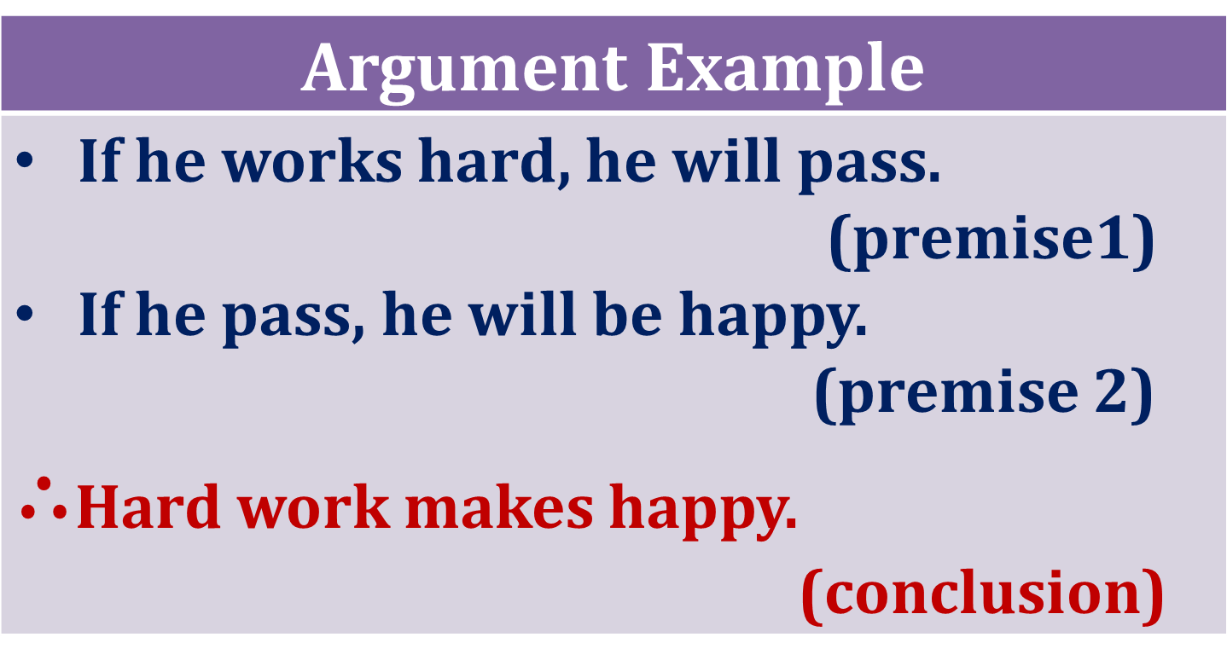
Argument Example

Slide 4
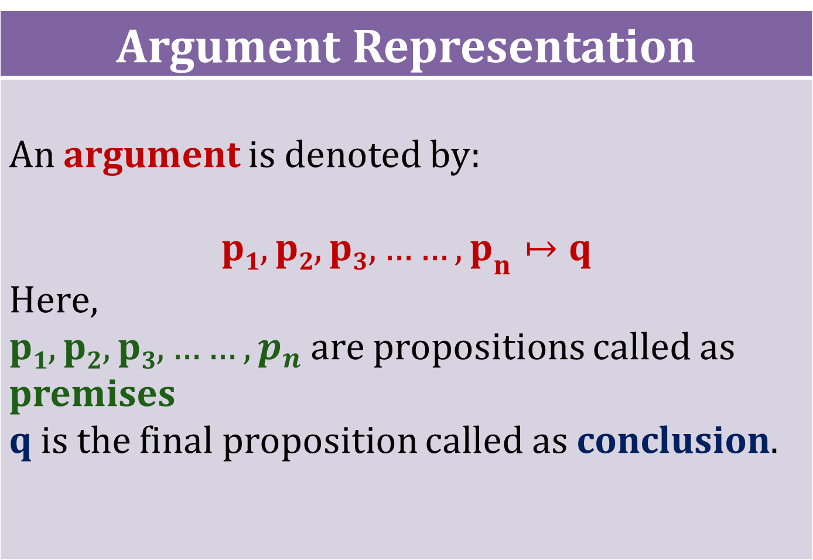
Argument Representation

Slide 5
Valid Argument
An argument is said to be valid if the conclusion is true whenever all the premises are true. An argument which is not true is called a fallacy.

Slide 6
Method to test Validity of an Argument
Identify the premises and conclusion of the argument. Construct the truth table showing the truth values for all the premises and conclusion. Find the rows (called critical rows) in which all the premises are true. In each critical row check If the conclusion is true the argument is valid. If there is atleast one critical row in which conclusion is false then the argument is fallacy.

Slide 7
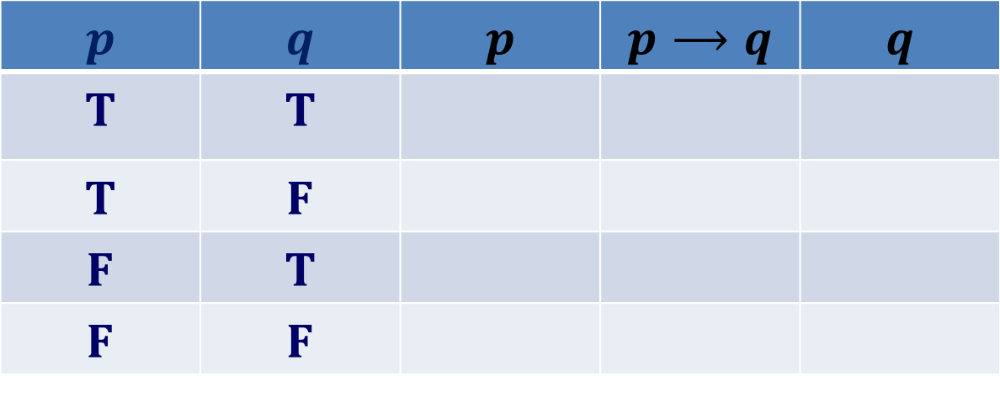
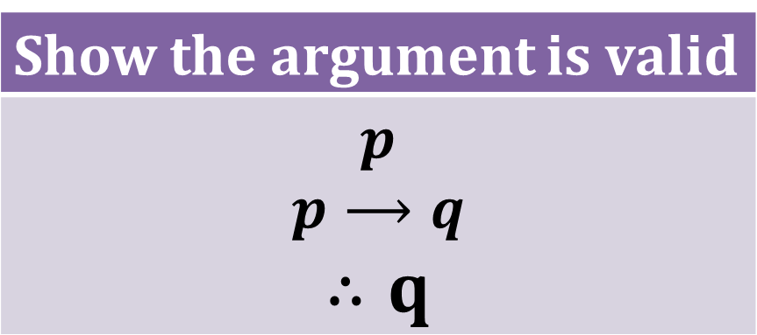
Show the argument is valid
$$p$$ $$p⟶q$$ $$∴q$$
Example 1
Identify premises and conclusion
Premises
Conclusion
Step1
$$p$$ | $$q$$ | $$p$$ | $$p⟶q$$ | $$q$$
T | T
T | F
F | T
F | F

Slide 8
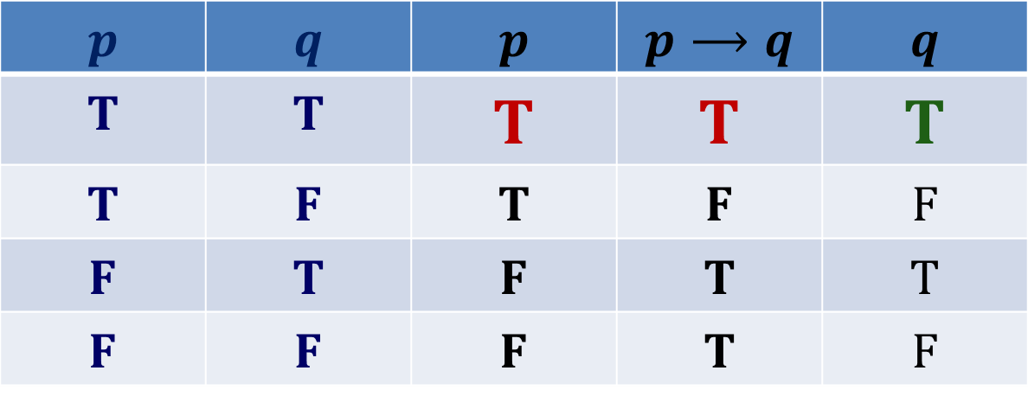
Construct Truth Tables
Step2
Truth Tables
$$p$$ | $$q$$ | $$p$$ | $$p⟶q$$ | $$q$$
T | T | T | T | T
T | F | T | F | F
F | T | F | T | T
F | F | F | T | F

Slide 9
Find Critical row
Step3
Critical row
$$p$$ | $$q$$ | $$p$$ | $$p⟶q$$ | $$q$$
T | T | T | T | T
T | F | T | F | F
F | T | F | T | T
F | F | F | T | F

Slide 10
Check Critical row
Step4
Critical row
$$p$$ | $$q$$ | $$p$$ | $$p⟶q$$ | $$q$$
T | T | T | T | T
T | F | T | F | F
F | T | F | T | T
F | F | F | T | F
In first row which is the critical row (since all the premises are true) and the conclusion is also true. Hence, the argument is valid.

Slide 11
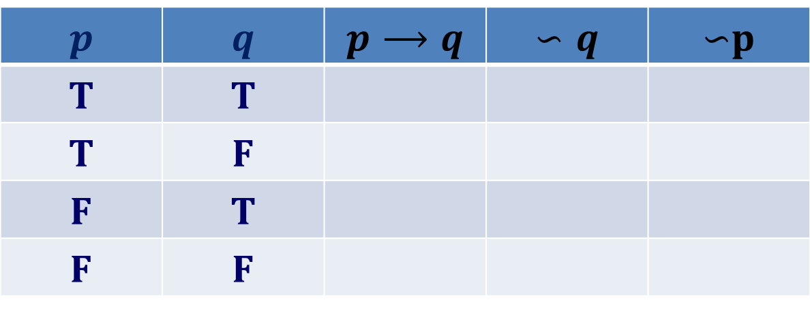
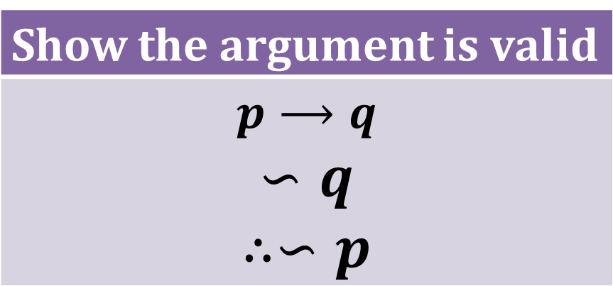
Show the argument is valid
$$p⟶q$$ $$∽q$$ $$∴∽p$$
Example 2
Premises
Conclusion
$$p$$ | $$q$$ | $$p⟶q$$ | $$∽q$$ | $∽$p
T | T
T | F
F | T
F | F

Slide 12
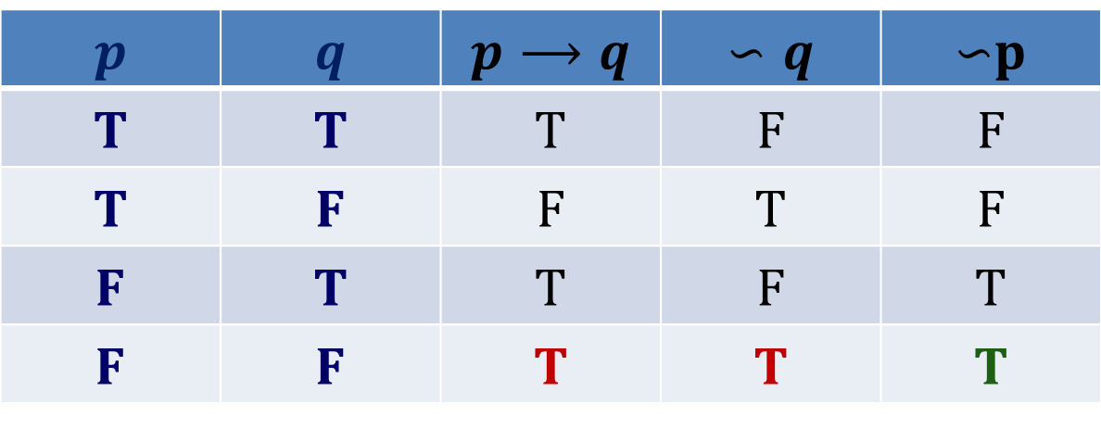
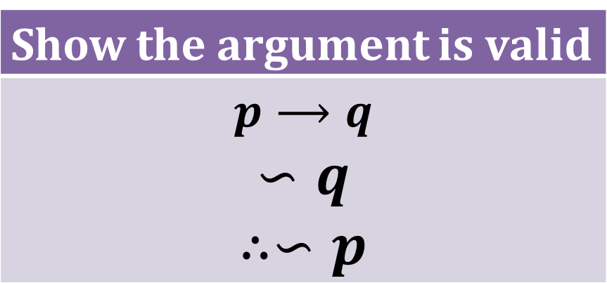
Show the argument is valid
$$p⟶q$$ $$∽q$$ $$∴∽p$$
Truth Tables
$$p$$ | $$q$$ | $$p⟶q$$ | $$∽q$$ | $∽$p
T | T | T | F | F
T | F | F | T | F
F | T | T | F | T
F | F | T | T | T

Slide 13
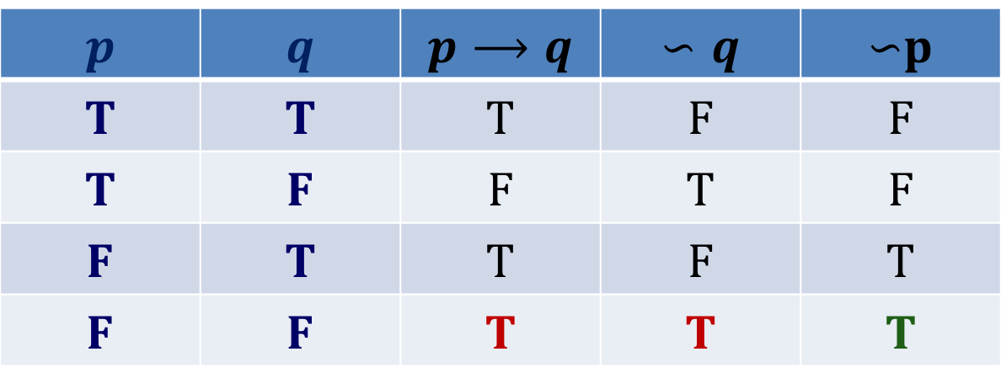
Show the argument is valid
$$p⟶q$$ $$∽q$$ $$∴∽p$$
Critical row
$$p$$ | $$q$$ | $$p⟶q$$ | $$∽q$$ | $∽$p
T | T | T | F | F
T | F | F | T | F
F | T | T | F | T
F | F | T | T | T
In first row which is the critical row (since all the premises are true) and the conclusion is also true. Hence, the argument is valid.

Slide 14
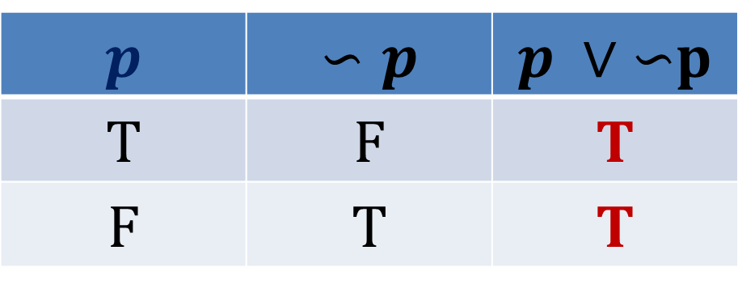
Tautology
A compound proposition which is always true regardless of truth values assigned to its component propositions is called a tautology
$$p$$ | $$∽p$$ | $p ∨ ∽$p
T | F | T
F | T | T
All T’s
Hence, the statement p ∨ ∽p is a Tautology.

Slide 15
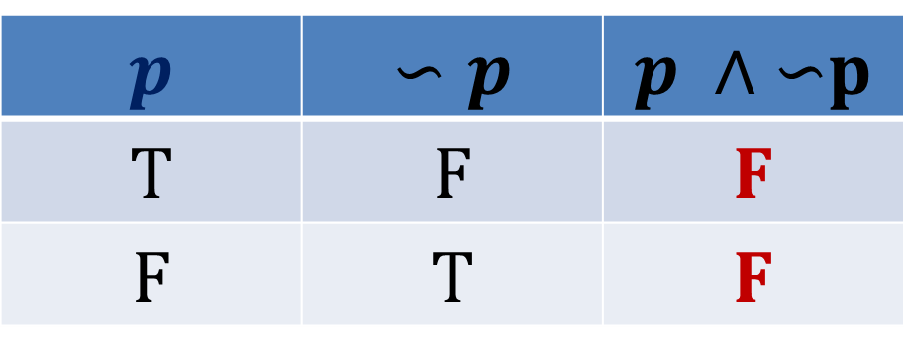
Contradiction
A compound proposition which is always false regardless of truth values assigned to its component propositions is called a contradiction
$$p$$ | $$∽p$$ | $p ∧ ∽$p
T | F | F
F | T | F
All F’s
Hence, the statement p $∧$ ∽p is a Contradiction.

Slide 16
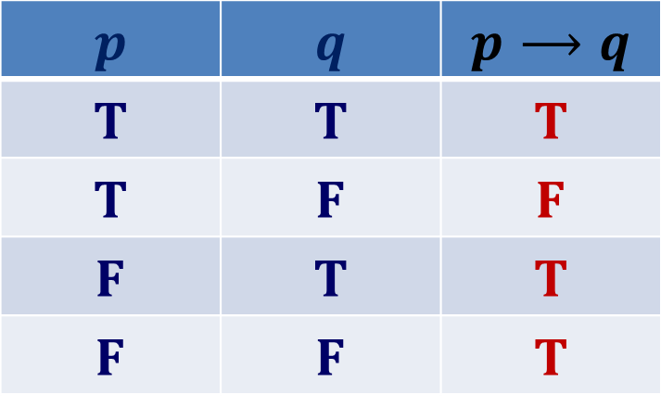
Contingency
A compound proposition which can either be true or false regardless of truth values assigned to its component propositions is called a contingency.
$$p$$ | $$q$$ | $$p⟶q$$
T | T | T
T | F | F
F | T | T
F | F | T
Either T or F
Hence, the statement $p⟶q$is a Contingency.

Slide 17


Quiz 5
Check if the following statement is tautology, contradiction or contingency?
$(p∧q)⟶(p∨q)$

Slide 18
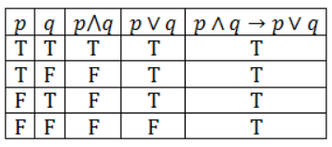
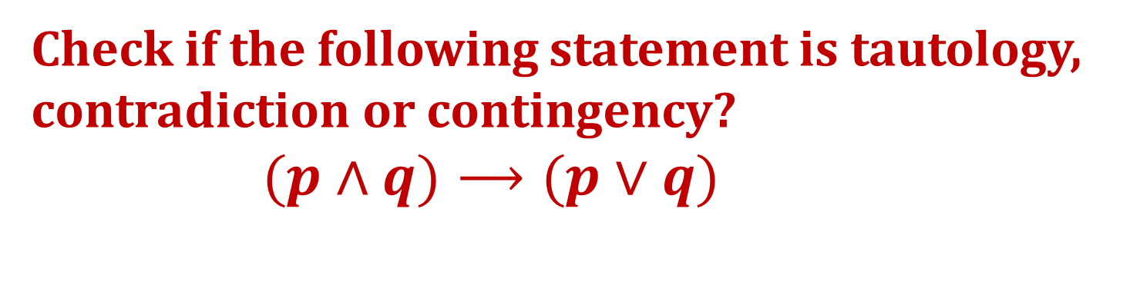
Quiz 5
Check if the following statement is tautology, contradiction or contingency?
$(p∧q)⟶(p∨q)$
Tautology

Slide 19
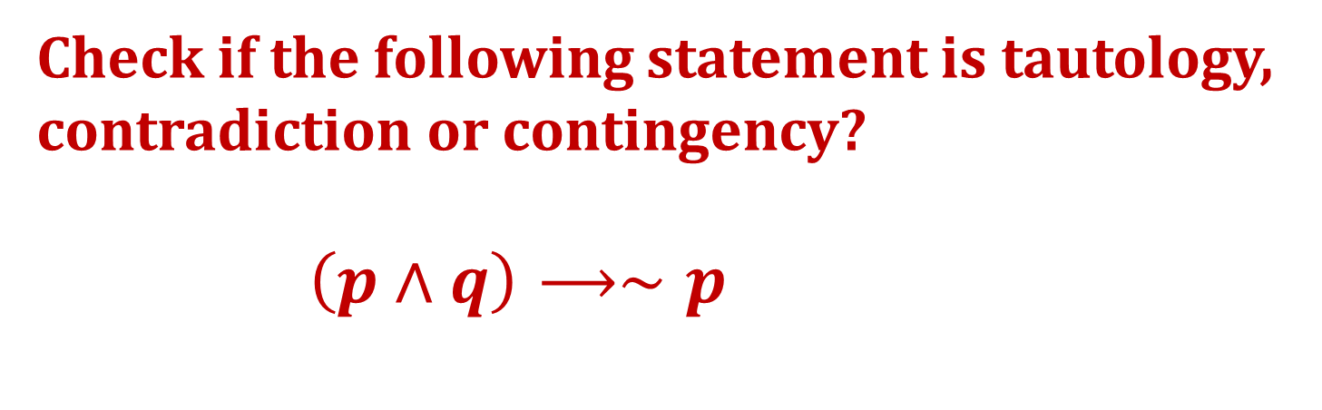
Quiz 6
Check if the following statement is tautology, contradiction or contingency?
$\left(p∧q\right)⟶∼p$

Slide 20
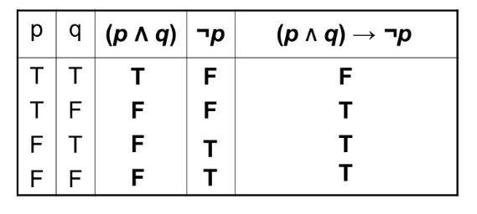
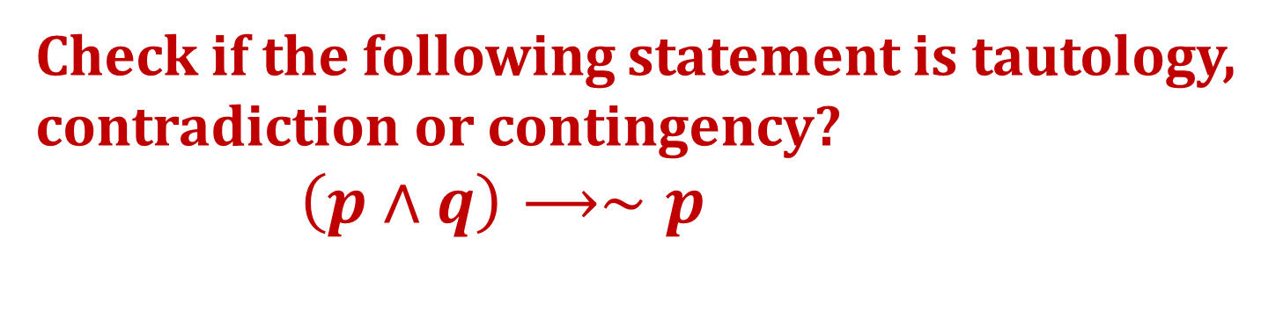
Quiz 6
Check if the following statement is tautology, contradiction or contingency?
$\left(p∧q\right)⟶∼p$
Contingency

Slide 21
Argument
An argument in propositional logic is a sequence of propositions.
All but the final proposition in the argument are called premises or hypotheses and the final proposition is called the conclusion.

Slide 22
Example
"If you have a current password, then you can log onto the network."
"You have a current password."
Therefore,
"You can log onto the network.“
This is an argument with two premises and a conclusion

Slide 23
Validity of Arguments
An argument is valid if the truth of all its premises implies that the conclusion is true.

Slide 24
Argument form
An argument form in propositional logic is a sequence of compound propositions involving propositional variables.
An argument form with premises p1, p2, p3, ... ,pn and conclusion q is valid, when (p1 ∧ p2 ∧ p3 ∧ ……∧ pn) → q is a tautology.
The key to showing that an argument in propositional logic is valid is to show that its argument form is valid.

Slide 25
Example
Consider an argument: If you have a current password, then you can log onto the network. You have a current password.Therefore,You can log onto the network.
Argument form
Let p represents "You have a current password"
and q represents "You can log onto the network."
Then, the argument has the form

Slide 26
Rules of Inference

Slide 27
Example

Slide 28
Example

Slide 29
Using Rules of Inference to Build Arguments

Slide 30
Example
Show that the hypotheses "It is not sunny this afternoon and it is colder than yesterday," "We will go swimming only if it is sunny," "If we do not go swimming, then we will take a canoe trip," and "If we take a canoe trip, then we will be home by sunset" lead to the conclusion "We will be home by sunset.“
contd..

Slide 31
Note that we could have used a truth table to show that whenever each of the four hypotheses is true, the conclusion is also true. However, because we are working with five propositional variables, p, q, r, s, and t, such a truth table would have 32 rows.

Slide 32
Example
Show that the hypotheses "If you send me an e-mail message, then I will finish writing the program," "If you do not send me an e-mail message, then I will go to sleep early," and "If I go to sleep early, then I will wake up feeling refreshed" lead to the conclusion ."If I do not finish writing the program, then I will wake up feeling refreshed. "
contd..

